Slide 1
Module 1 - Introduction to Digital Services
The Who, What, and How of Digital Service Delivery
Presented by: [Facilitator Name]
Date: [Session Date]
Notes:
Speaker Notes: Welcome to Module 1. In this module, we’ll explore the key concepts behind digital service delivery, what it means for government, and why it matters for acquisition professionals like you.

Slide 2
Module 1 Performance Outcome
Describe digital services in the 21st century, including what they are, who provides them, how they are delivered, and why they are important.

Slide 3
At the conclusion of this module, you will be able to
Define digital services.
Identify key players in the digital services ecosystem.
Identify strategies to help you identify user needs.
Describe contemporary practices used to develop digital services.
Notes:
Speaker Notes: These are our learning objectives for the module. As we go through each section, think about how these concepts connect to your own role and the challenges your agency faces.

Slide 4
Sprint 1
The Digital Services Landscape

Slide 5
Digital Services – The Who and The What

Slide 6
Defining Digital Services
“Digital services” refers to “the delivery of digital information (data or content) and transactional services (e.g., online forms, benefits applications) across a variety of platforms, devices, and delivery mechanisms (e.g., websites, mobile applications, and social media).” Digital services may be delivered to internal customers, external customers, or both.
-Digital Government Strategy
Notes:
Speaker Notes: Digital services aren’t just websites—they’re how people interact with government in the digital age. Think of tools like USAJobs, IRS.gov, or agency portals. They must be accessible, secure, and user-focused.

Slide 7
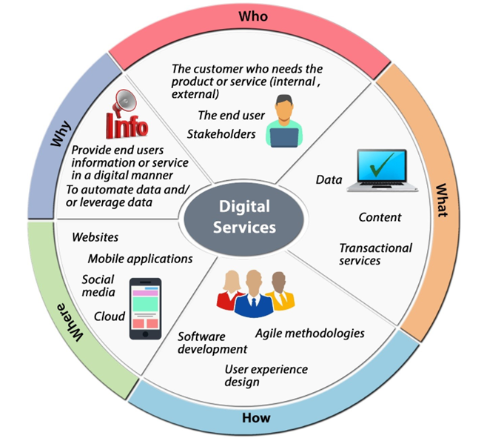
Digital Service Wheel
Image placeholder
Notes:
Speaker Notes: This wheel visually breaks down digital services into five key areas: Who, What, How, Where, and Why. Starting with the 'Who,' it's all about the customer and end-users we serve. The 'What' encompasses the data, content, and transactional services we provide. 'How' refers to the methodologies like software development, agile, and user experience design that bring services to life. The 'Where' covers platforms like websites, mobile apps, social media, and the cloud. Finally, the 'Why' clarifies our purpose: providing digital information or services and leveraging data. At the core, 'Digital Services' integrates all these aspects for a cohesive digital experience for users.

Slide 8
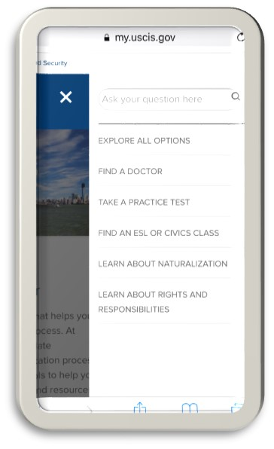
Then and Now: USCIS.gov Use Case
Before: Long in-person paper-based process
Now: myUSCIS.gov – digital, self-guided, mobile-friendly
Goals: Reduce burden, increase access, streamline backend processing
Notes:
Speaker Notes: This USCIS example highlights how digital transformation can improve experience, efficiency, and outcomes. Think about how procurement supports transitions like this through contracts and tools.

Slide 9
The 5 Ws of Digital Services (USCIS Example)
Who: Immigration applicants
What: Online access to status
Why: Improve efficiency
Where: Web/mobile
How: Iterative build and test with users
Notes:
Speaker Notes: Thinking back to the digital service wheel, think about explore who benefits, what the service is, and how it was built, etc. These questions are useful when evaluating or planning digital procurements.

Slide 10
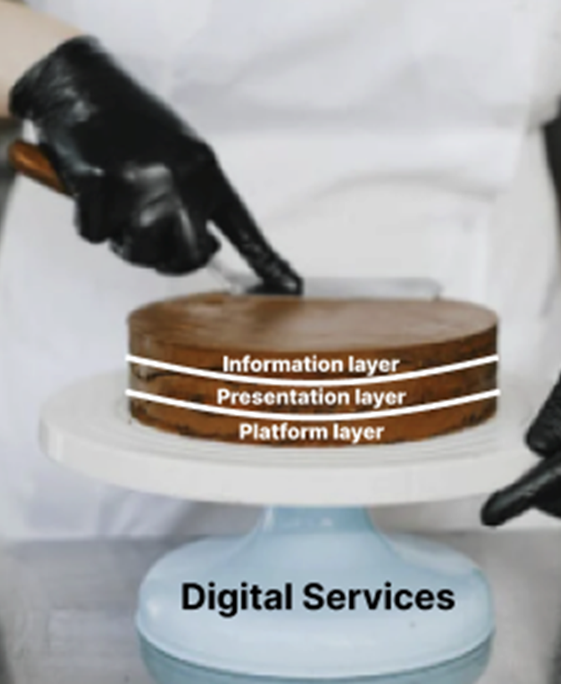
Digital Services as a Layered Cake
Three layers:
Information
Content, transactions, multimedia, data
Presentation
Web browsers, apps
Platform
Application Programming Interfaces (APIs), Web Services, Web Content Management Systems
Notes:
Speaker Notes: Digital services are made up of three essential layers, like a layered cake.
The Information Layer includes all the content and data that users interact with—whether that’s reading a press release, applying for a benefit, or watching a video.
The Presentation Layer is the “where” and “how” users access this information—through web browsers, mobile apps, or social media.
And finally, the Platform Layer is the foundation. It’s where the business logic happens and includes tools like APIs and content management systems.
This bottom layer also ensures security, privacy, and data protection are built in from the start, providing a stable platform for digital services to operate safely and reliably.

Slide 11
The Digital Services Ecosystem

Slide 12
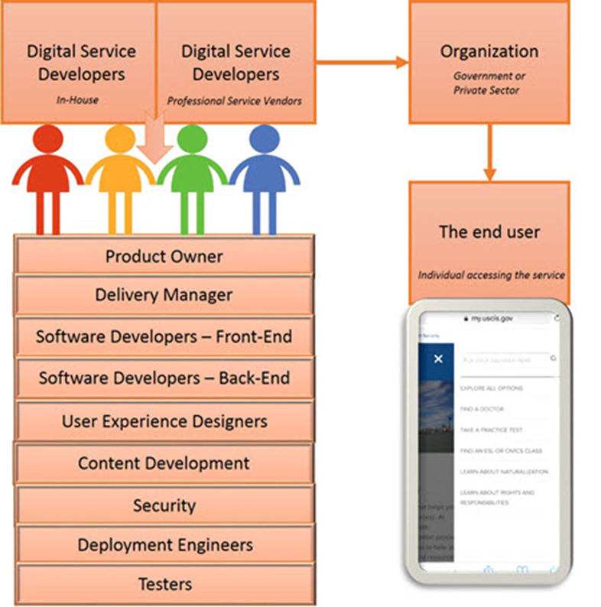
Who Provides Digital Services?
Multidisciplinary government teams and vendors
Key roles: Product Owners, Developers, Designers, Security, QA
Balance of internal staff and contractors
Notes:
Speaker Notes: Digital services are built by collaborative teams that blend policy, design, and tech. Your role is often to help these teams get the right resources and vendors in place.

Slide 13

Who Benefits from Digital Services?
End users (e.g., citizens, applicants, veterans)
Internal government users
Program offices and policy makers
Notes:
Speaker Notes: Services should serve real user needs—whether that’s the public or internal stakeholders. Good acquisition work ensures these users are kept in mind through every stage.

Slide 14
Local, State, Federal Examples
IRS
USA Jobs
Maryland Department of Transportation

Slide 15

Activity: Discussion
What digital services have you used?

Slide 16
Who’s Who: A Starting List

Slide 17
Who’s Who in Digital Services
Government entities (e.g., GSA, USDS, CMS DS, CDAO)
Non-government partners (Code for America, USDR)
Thought leaders (Pahlka, Meyer, Walker, etc.)
Notes:
Speaker Notes:
Many government teams—and their partners—contribute to advancing digital delivery. These groups create resources, prototypes, and momentum for modern practices.

Slide 18

Activity: Who’s Who of Digital Services Teams
Purpose: Build awareness of digital service teams (DSTs) across government
Focus: Missions, structures, projects, practices
Goal: Connect DSTs to acquisition work
Breakout exploration – 20 min
Group report-out – 20 min
Large-group debrief – 10 min
Notes:
Speaker Notes: Now we’re going to dive into an activity called Who’s Who of Digital Services Teams. The goal is to start recognizing the landscape of digital-native teams across government. By learning what they do, how they’re structured, and the kinds of projects they work on, you’ll see how they might show up as partners, stakeholders, or end users in your acquisitions.

Slide 19
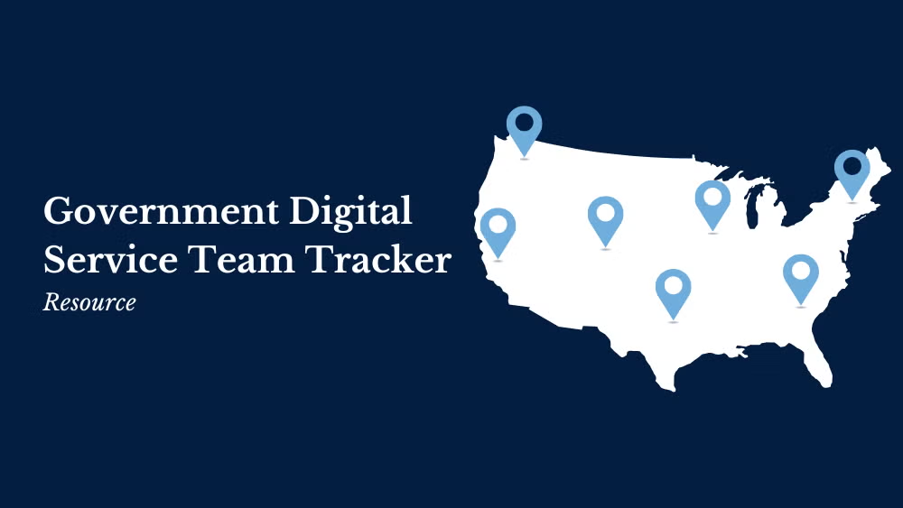
Activity: Who’s Who of Digital Services Teams
Notes:
Speaker Notes: I’ll take a few minutes to show you the DST Tracker, where you’ll explore these teams. You can filter by federal or state, see team maturity, and browse projects. I’ll walk through one example so you get a sense of what to look for.
https://digitalgovernmenthub.org/publications/dsn-dst-tracker/

Slide 20
Activity: Who’s Who of Digital Services Teams
In your breakout rooms:
Select one DST from the tracker.
Review its organization, mission, and recent work.
Identify examples of how the team delivers and supports its projects (e.g., partnerships, tools, public deliverables, open source repos).
Capture findings in the template.
Notes:
Speaker Notes: Once you’re in breakout rooms, your group will pick one DST to explore. Review their mission, structure, and projects. Look at how they deliver, who they partner with, and what they share publicly. Use the template provided to capture your notes.
20 minutes for breakout rooms

Slide 21
Activity: Who’s Who of Digital Services Teams
What to look for:
Team Name & Level of Gov’t
Mission/Vision/Values
Known Projects/Services
What kind of project are they working on? Any case studies?
Delivery practices
Any hints at how they work?
Stakeholders or Partners
Other agencies, state/local govt, vendors
Impact or Outcomes
Metrics, user stories, testimonials
Publicly Shared Artifacts
Design guides, playbooks, blog posts, open source repos
Notes:
Speaker Notes: This template will guide your breakout conversation. You don’t need to capture everything—focus on what’s most interesting or relevant to your group.
You’ll have 20 minutes in groups of 3–5. Use the tracker, select your DST, and fill in the template. We’ll pop into rooms to answer questions or offer guidance.

Slide 22
Activity: Who’s Who of Digital Services Teams
Each group reports out:
Which DST & why
What caught your attention
What project stood out
What surprised you
What aligns with your experience
Notes:
Speaker Notes: “After breakouts, each group will have 5 minutes to share highlights. We’d love to hear not just the facts, but what caught your attention or surprised you, and how it connects back to your own procurement experience.
20 minutes for group report outs

Slide 23
Activity: Who’s Who of Digital Services Teams
Group debrief:
Similarities/differences between DSTs?
Any innovative practices you noticed?
How might this influence your approach to procurement?
Notes:
Speaker Notes: 10 minutes
To wrap up, we’ll reflect as a full group.
What similarities or differences stood out?
Were there any practices or strategies worth carrying into your own acquisitions?
And how might knowing about these teams change how you think about procurement or collaboration?

Slide 24

Case Study Activity:
Introducing Casey and the CRM Project
What challenges is Casey already facing that reflect the realities of digital acquisition?
What digital delivery challenges might Casey face based on what we know so far?
Notes:
Speaker Notes:

Slide 25
Sprint 2
Digital Service Methods, Roles, and Sources of Supply
Notes:
Speaker Notes:
Welcome! In this session, we’ll look at practical ways to design and develop digital services that truly meet user needs. We’ll touch on strategies, real-world practices, and government tools you can apply.

Slide 26
Digital Services – The How

Slide 27
Learn about your users’ needs

Slide 28
Developing with the End User in Mind
Why This Matters
Pace of digital change
Pressure to deliver better services, faster
Government must work smarter, not just harder
Notes:
Speaker Notes:
The pace of change in tech—and public expectations—means government needs new ways to work. We’ll focus on development strategies that make services more effective and user-centered.

Slide 29
Start with the End User
”Understand what people need” – Play 1, USDS Playbook
No matter the agency or service, users come first
Notes:
Speaker Notes: Every digital service should begin with understanding what people need. This is the foundation of Play 1 in the U.S. Digital Service Playbook—and the common denominator of successful projects.

Slide 30
Activity: Discussion
What commercial companies or government agencies do you know of that keep user needs at the forefront? How does this show? What steps do you think they took to get to where they are?
What commercial companies or government agencies do you know of that didn’t prioritize user needs? What were the consequences?
Notes:
Speaker Notes: Let’s reflect. Think about examples where agencies or companies focused on users—and where they didn’t. What were the outcomes? This sets the stage for understanding why this work matters.

Slide 31
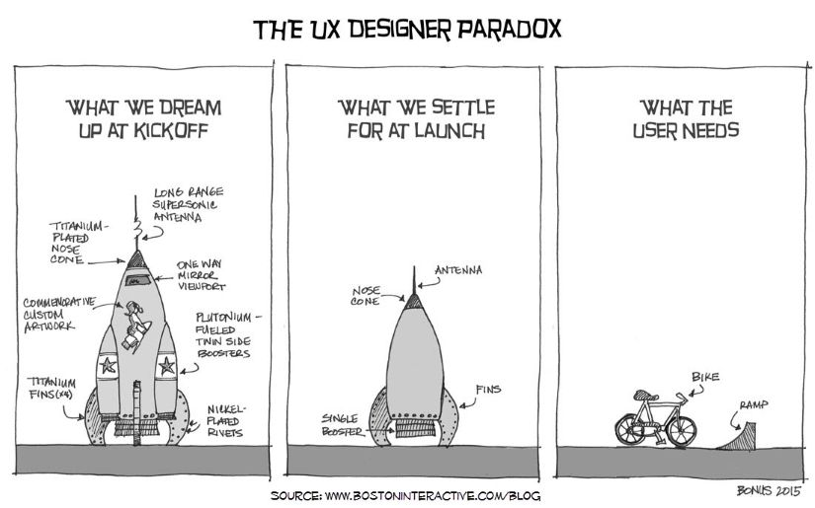
The UX Designer Paradox
Notes:
Speaker Notes: This comic captures the reality of many projects. We often design from assumptions, not evidence. Good user-centered design aims to close that gap.

Slide 32
Strategies
Talk to real users.
Use interviews, surveys, observation.
Don’t rely on assumptions.
Capture findings and patterns.
Share with teams and leadership.
Build shared understanding.
Do your research
Document and Share
Prototype early.
Keep testing throughout development.
Use feedback to shape direction.
Create user stories
Focus on what people actually want to do.
Let that guide development.
Lead with User Needs
Test Early and Often
Notes:
Speaker Notes: To understand what users need, you have to talk to them—and not just once. Combine interviews and data to uncover real goals and challenges.
Testing shouldn’t wait until the end. Early and continuous feedback helps catch problems and adapt quickly—saving time and increasing success.
Document what you learn. It’s not just helpful—it’s essential for bringing the whole team along and making better decisions.
Let user needs shape your backlog. This ensures that what gets built is relevant and useful, not just what was easiest to write into a contract.

Slide 33
Minimum Viable Product (MVP) and Lean Startup
Lean Startup is a method for building products through rapid experimentation, continuous user feedback, and iterative design to minimize waste and increase the chances of success.
The MVP is a core component of of Lean Startup
Definition: The simplest version of your product to test hypotheses about customer needs
Still needs to deliver value!
Purpose: To validate assumptions and gather feedback
Notes:
Speaker Notes: Let’s talk about Lean Startup and how it connects to digital service delivery.
Lean Startup is a method that emphasizes building products through rapid experimentation, learning directly from users, and continuously refining based on what you learn. The goal is to avoid investing a lot of time and resources into something users may not actually want or need.
A key concept in Lean Startup is the Minimum Viable Product, or MVP. An MVP is the simplest version of a product that still delivers real value to users. It’s not a prototype or mockup—it’s something functional, but stripped down to its core features.
The purpose of the MVP is to test assumptions about user needs and gather feedback quickly. This lets you validate whether you're on the right track before committing to full-scale development.
So in government digital services, using an MVP approach can help teams build smarter and deliver better outcomes with less waste.
Reduces risk and waste of resources.
Focuses on user needs and data-driven decisions.
Enables rapid learning and iteration.
Example: The Department of Education’s college scorecard prototype.

Slide 34
What does an MVP look like?
It can be very simple:
A wireframe
A clickable prototype
PowerPoint slide deck
It just needs to be “enough” to get real feedback.
Notes:
Speaker Notes: Now that we’ve defined what an MVP is, let’s talk about what it actually looks like in practice. One important thing to remember is that an MVP doesn’t have to be complex or polished. It just needs to be “enough”—enough to communicate your idea and get real, actionable feedback from users.
Some common examples include:
A wireframe that shows layout and flow
A clickable prototype that simulates functionality
Or even just a PowerPoint slide deck that walks through the concept visually
The key is that the MVP helps you test your assumptions. It’s not about perfection—it’s about learning quickly and minimizing wasted effort. You can then iterate based on what you learn before investing in full development.
This is especially useful in government settings, where budgets and timelines are tight and expectations are high.

Slide 35


What happens after MVP testing?
Gather user feedback
Document your findings
Analyze whether your assumptions were correct
Pivot or persevere?
Notes:
Speaker Notes: After reviewing your data:
Pivot: Change direction if your assumptions were wrong
Persevere: Keep going if the feedback confirms your approach

Slide 36
Knowledge check
Which of the following best describes the purpose of an MVP (Minimum Viable Product)?
A. To deliver a final product as quickly as possible
B. To create a highly detailed prototype with full functionality
C. To test assumptions about user needs using a lightweight version of a product
D. To present executive stakeholders with polished features for approval

Slide 37
Knowledge check
Which of the following best describes the purpose of an MVP (Minimum Viable Product)?
A. To deliver a final product as quickly as possible
B. To create a highly detailed prototype with full functionality
C. To test assumptions about user needs using a lightweight version of a product
D. To present executive stakeholders with polished features for approval

Slide 38
User Research Techniques
A/B Testing
Personas
Journey Mapping
Notes:
Speaker notes: We’re going to explore several techniques that help us better understand and serve our users, whether we're building a website, a tool, or any digital service. We’ll look at A/B testing, personas, and journey mapping—tools that make sure our decisions are grounded in what real people need, not just assumptions or internal opinions.

Slide 39
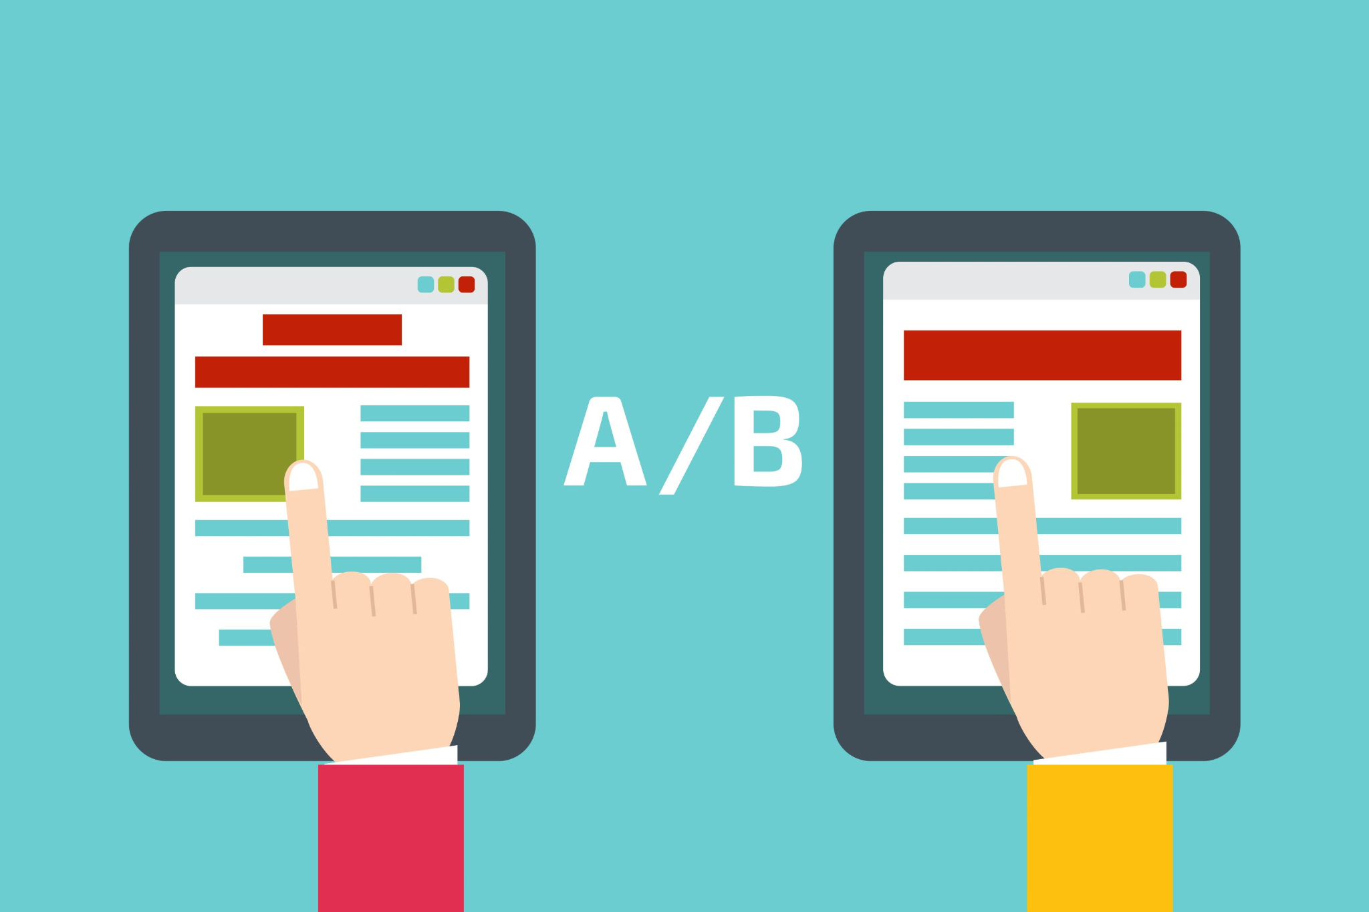
A/B Testing
A method for testing and refining ideas in real time
Can apply to layout, wording, imagery, or even button placement
Turns subjective decisions into data-driven choices
Why A/B Testing Works
Provides quick, measurable feedback
Low-risk experimentation
Helps teams iterate faster and more confidently
Notes:
Speaker Notes:
Let’s start with A/B testing. This is a simple but powerful method that allows us to test different versions of a digital component—like a headline, image, or layout—and see which one performs better. Instead of guessing what will resonate, we can actually put both versions in front of users and use the results to drive decisions.
Why is A/B testing so useful? First, it gives us real-time, measurable feedback. It allows us to make small, data-driven changes with low risk. And when applied well, it speeds up iteration, helping teams avoid analysis paralysis or decision-making based on opinions alone. This is especially helpful when there’s internal disagreement, let the data decide.

Slide 40
Personas
Fictional characters based on real user data
Focus on goals, behaviors, and needs
Help teams align around who they’re building for
Why Personas Matter
Help ground decisions in user reality
Prevent teams from chasing trends or internal preferences
Anchor development to what actually matters to users
Notes:
Speaker Notes: Next, let’s talk about personas. A persona is a fictional character created from real user research. It’s not a stereotype—it’s a way to represent common goals, challenges, and behaviors of a group of users. Personas help teams stay grounded in user needs and avoid designing for themselves or for leadership preferences.
It’s easy for teams to get distracted by what’s trendy or technically interesting. Personas help keep us focused. They remind us that our job is to solve real problems for real people. When decision-making gets complicated or stakeholders start pulling in different directions, personas help us return to a user-centered foundation.

Slide 41
Activity: Discussion
Think about a service your agency provides. If you had to create a persona for one of your users, what are three things you would include about their needs or behaviors?
Notes:
Optional follow-up: How might those needs shape your development decisions?

Slide 42
Journey Mapping
Visualizes the user’s experience across touchpoints
Includes feelings, questions, and moments of friction
Often built on top of personas for deeper understanding
Notes:
Speaker Notes:
Journey mapping is another key technique—it helps us visualize the user’s experience from start to finish. What are they trying to do? What pain points or frustrations might they encounter? By mapping out each step, we can design better solutions and identify where users might fall through the cracks. Personas are often the starting point for building an effective journey map.

Slide 43
Why these tools matter
A/B testing lets you experiment with confidence.
Personas keep user needs front and center.
Journey maps help teams empathize across the full experience.
Together, they build better, user-aligned services.
Notes:
Speaker Notes:
To wrap up, remember that tools like A/B testing, personas, and journey mapping are not just checkboxes in a design process—they’re practical ways to make sure our services are grounded in the real experiences of users. A/B testing gives us fast, reliable data for making decisions. Personas help us keep the user front and center throughout development. And journey maps allow us to see the bigger picture—how users experience our service over time. When used together, these techniques help us create more thoughtful, effective, and user-aligned digital services.

Slide 44
Contemporary Practices in Developing Digital Services
Notes:
Speaker Notes: Now that we’ve talked about the common foundation of digital service development—starting with the end user—it’s time to dive into contemporary practices that are helping agencies deliver better digital services today.
This next section is meant to give you a broad survey, not a deep dive, into current methodologies. It’s not an exhaustive list, but it’s a solid starting point to build your awareness. Keeping up with evolving tools and approaches takes effort, and this content is designed to help you begin that journey.
As procurement professionals, your role is critical. The way contracts are written, evaluated, and managed shapes how digital services are delivered.
You’ll hear terms like Agile, Human-Centered Design (HCD), and DevSecOps. These aren’t just buzzwords—they’re real strategies that have led to better results in both the public and private sectors. These methods help teams:
Adapt quickly to changing needs,
Deliver usable features more frequently, and
Reduce waste and rework.
They also offer greater visibility into how vendors are performing, which supports smarter use of taxpayer dollars. As you review proposals, having a working knowledge of these practices will help you recognize strong technical approaches—and flag red flags early.

Slide 45
Digital Service Delivery Methods: Agile

Slide 46
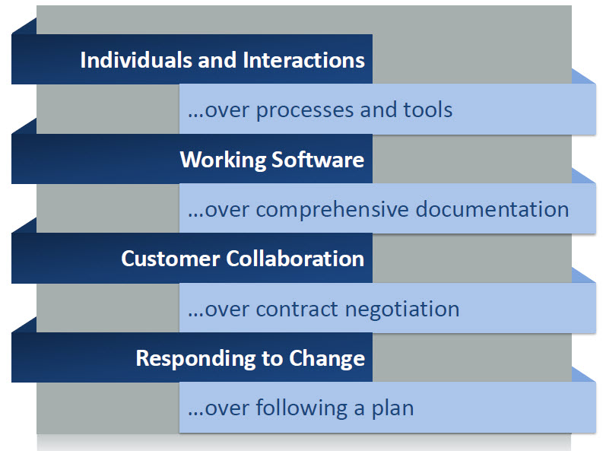
Agile Manifesto
Notes:
Speaker Notes: The Agile Manifesto
We are uncovering better ways of developing
software by doing it and helping others do it.
Through this work we have come to value:
Individuals and interactions over processes and tools
Working software over comprehensive documentation
Customer collaboration over contract negotiation
Responding to change over following a plan
That is, while there is value in the items on
the right, we value the items on the left more.
https://agilemanifesto.org/

Slide 47
What is Agile Delivery?
Agile - Iterative, feedback-driven development
Responding to change over following a rigid plan
Collaboration, adaptability, transparency
Culture shift/departure from waterfall delivery
Notes:
Speaker Notes:
Agile is about staying adaptable and learning as you go. That mindset changes how you write contracts and what you expect from vendors.

Slide 48
Key elements of Agile Delivery
Iterative development through sprints
Working product at sprint end
Frequent demos and reviews
Continuous refinement and planning
Transparency in workflows
Focus on working software over extensive documentation
Notes:
Speaker Notes: Let’s take a closer look at what Agile delivery actually looks like in practice. These are some of the key elements that define how Agile teams work and deliver value.
First, iterative development through sprints means that work is broken into short, time-boxed cycles—typically 1 to 4 weeks. Each sprint ends with a working product, even if it’s just a small improvement. That means the team delivers value early and often, rather than waiting months for a big launch.
Frequent demos and reviews are another core practice. At the end of each sprint, teams share their progress with stakeholders—this creates regular checkpoints and opportunities for feedback.
There’s also a focus on continuous refinement and planning. Agile teams don’t just plan once at the beginning—they adjust their priorities and backlog based on what they learn as they go.
Transparency in workflows is also key. Tools like digital boards or kanban systems help everyone—from developers to product owners to contracting officers—see what’s being worked on and what’s coming next.
And finally, Agile emphasizes working software over extensive documentation. That doesn’t mean documentation isn’t important, especially in government—but the priority is to deliver functioning, usable services that meet real needs.
For procurement professionals, recognizing these patterns can help you better assess vendor proposals and delivery plans aligned with Agile principles.

Slide 49
Agile vs Artisanal vs Waterfall
Agile emphasizes communication, collaboration, and upfront documentation.
Artisanal projects: unplanned, accumulated features, "spaghetti code".
Waterfall: rigid, linear, delays feedback, costly changes.
Notes:
Speaker notes: Let’s compare three different approaches to building digital services: Agile, Artisanal, and Waterfall.
Agile emphasizes communication and collaboration between teams and stakeholders, with just enough upfront documentation to get started. Agile teams work iteratively, get frequent feedback, and adjust based on what they learn. It’s flexible and designed to deliver value early and often.
On the other hand, Artisanal projects are often unstructured. There’s no real plan, and features tend to accumulate without a clear strategy—resulting in what developers sometimes call “spaghetti code.” It may work for a while, but it becomes hard to maintain or scale.
Finally, Waterfall is a traditional, linear approach. You gather all the requirements first, then design, build, test, and launch—each phase happens in sequence. The problem with Waterfall is that it delays feedback until the end, so if something isn’t working, it’s often expensive and time-consuming to fix.
Agile aims to strike a balance—planning just enough to move forward, but keeping flexibility so teams can adapt. As acquisition professionals, it’s important to recognize the delivery method behind a proposal—and understand the risks and benefits of each.

Slide 50
USDS Playbook and Agile
Play 4: Agile Development in the USDS Playbook.
Notes:
Speaker Notes: Play 4 of the U.S. Digital Services Playbook is all about using Agile development methodologies. The key message is that government digital service projects should be built iteratively and should evolve based on feedback and learning—not rigid, static requirements.
Agile isn’t just a technical practice—it’s a mindset shift. It encourages teams to break down big problems into smaller, manageable pieces and to deliver value continuously rather than waiting for a big launch months—or years—down the line.
In this play, USDS recommends working in short sprints, shipping early and often, and involving users throughout. Agile development helps teams respond to change, whether that’s new information, changing policy, or stakeholder input.
As procurement professionals, supporting Agile means writing contracts that allow for incremental delivery, flexible scope, and ongoing collaboration with vendors. It also means being open to learning as you go—and building in room for that learning to shape the final outcome.

Slide 51
Agile Team Roles
Common roles include:
Product Owner (PO) / Product Manager (PdM) – The expert who sets priorities, gathers requirements, and collaborates daily with the team.
Scrum Master or Project Manager (PjM) – Facilitates meetings, resolves impediments, and supports team flow.
Developers – Engineers who create front-end, back-end, or full-stack code, manage server platforms, and ensure code and platform integrity through continuous testing.
Accessibility Specialist – Embeds Section 508 compliance throughout development.
Security & Compliance Expert – Oversees vulnerability testing, patching, and compliance reviews.
HCD Designers & Researchers – Create designs, workflows, and prototypes based on user needs and research data, collaborate with developers to bring the designs to code, and conduct discovery and usability studies.
Notes:
Speaker Notes:
These teams are built to deliver iteratively and adapt quickly. Understanding team structure helps you match acquisition approaches to actual delivery rhythm.

Slide 52
Agile Practices
Assign a Project Manager or Scrum Master
Sprint planning, review, retrospective
Daily stand-up
Backlog refinement
MVP approach
Integrate HCD and Lean UX
Prioritize accessibility
Run usability tests frequently
Combine Agile with DevOps
Create transparency via project scaffolding

Slide 53
Final thoughts
Agile is a mindset of continuous improvement.
Open communication and user-centered design.
Supporting digital transformation and informed procurement decisions.
Notes:
Speaker Notes:
To wrap up, Agile is more than just a process—it’s a mindset of continuous improvement, always looking for ways to learn, adapt, and get better.
It thrives on open communication within teams and stakeholders, fostering transparency and collaboration.
At its core, Agile embraces user-centered design, ensuring solutions truly meet user needs.
Ultimately, Agile supports digital transformation by enabling organizations to respond quickly to change and innovate.
It also helps guide informed procurement decisions by focusing on delivering real value early and often.

Slide 54
Activity: Discussion
Think back to a digital service or IT project you were involved in—whether as a contracting officer, program manager, or stakeholder. Based on what you now know about agile, what might you have done differently to encourage more adaptability, feedback, or user involvement?
Notes:
Follow-up prompts (for facilitation):
-What barriers would have made agile adoption difficult?
-How might early stakeholder feedback have changed the project outcome?
-What role could you have played in making the process more iterative or user-centered?

Slide 55
Digital Service Delivery Methods: HCD and DevSecOps

Slide 56
What is Human-Centered Design (HCD)?
Definition: Putting people at the heart of the design process.
Focus on understanding user needs, behaviors, and emotions.
HCD in federal digital service projects: A mindset and methodology.
Notes:
Speaker Notes: Human-Centered Design, or HCD, is about putting people—the users—at the center of the design process.
At its core, it’s a way of working that focuses on understanding user needs, behaviors, and emotions. The goal is to design services that truly work for the people who use them—not just what we assume they need, or what looks good on paper.
In federal digital service projects, HCD is both a mindset and a methodology. It means engaging with users throughout the project—not just during initial research or final testing—and continuously shaping the service based on what you learn.
For procurement professionals, understanding HCD helps you craft requirements that encourage vendors to do this kind of user-centered work, rather than simply delivering a static list of features. It also helps you evaluate whether proposed solutions are grounded in real user insights.

Slide 57
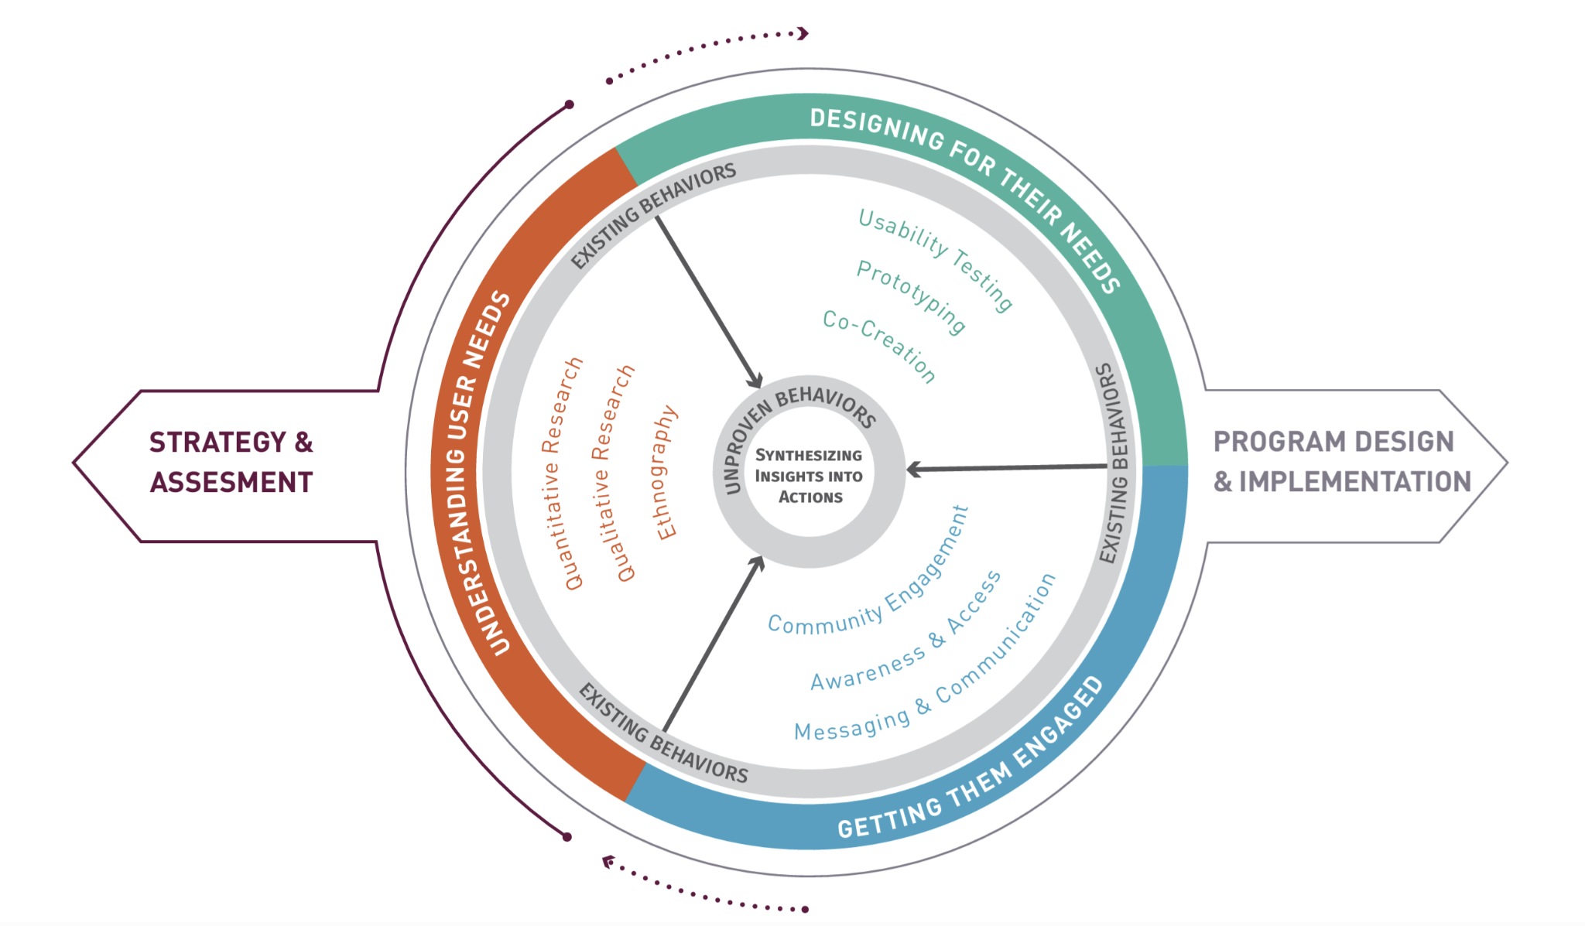
Core principles of HCD
Empathy: Understanding user experiences.
User Research: Engaging directly with users.
Iterations: Testing and refining solutions.
Usability Testing: Ongoing user interaction with prototypes.
Design for Everyone: Inclusive design and accessibility.
Collaboration: Cross-functional teamwork.
Notes:
Speaker Notes: These are some of the core principles behind Human-Centered Design—and they’re important to keep in mind when evaluating how digital services are being designed and delivered.
First is Empathy—really understanding the user’s experience, their pain points, and their goals. This is what drives meaningful design.
User Research is how we build that understanding—by engaging directly with users, listening to their stories, and observing how they interact with services.
Iterations are key—rather than trying to get everything perfect the first time, teams build prototypes, test them, and refine the solution through cycles of learning.
Usability Testing brings real users into the process throughout development, ensuring the service works in practice—not just in theory.
Design for Everyone means building with inclusion in mind, ensuring accessibility for people of all abilities and backgrounds. This goes beyond compliance—it’s about true usability for the full range of users.
And finally, Collaboration—HCD depends on cross-functional teamwork. Designers, developers, content specialists, product owners, procurement professionals—all working together with users to co-create better services.
As procurement professionals, looking for these principles in vendor proposals and delivery plans helps ensure the end product will truly meet user needs.

Slide 58
HCD in Government
Shifting focus from policy/system constraints to user needs.
Ensuring digital tools are functional, equitable, and accessible.
Real-world example: VA.gov redesign.
Notes:
Speaker Notes: Applying Human-Centered Design in government often requires a mindset shift—moving the focus from policy and system constraints to the needs of the people we’re serving.
It’s about asking, “How do users experience this service?” rather than just, “Are we complying with the policy?”
When done well, HCD helps ensure that the digital tools we build are not only functional, but also equitable and accessible—usable by all members of the public, including those with disabilities, different levels of digital literacy, or varying access to technology.
A great example of this is the VA.gov redesign. The VA used HCD practices to simplify navigation, improve usability, and make it easier for Veterans to find and access the services they need. It wasn’t just a cosmetic update—it was about transforming the experience around real user needs.
As procurement professionals, this means writing contracts and evaluating proposals in ways that prioritize these outcomes—not just technical specs. It’s about helping shape services that truly serve the public.
1. VA.gov Redesign – Department of Veterans Affairs
The VA undertook a comprehensive redesign of VA.gov to improve the digital experience for Veterans. By employing HCD principles, they focused on understanding Veterans' needs and behaviors, leading to a more intuitive and accessible website. This approach resulted in increased user satisfaction and trust in VA services.
Key Resources:
Designing for Veterans: A Toolkit for Human-Centered Design
Using Human-Centered Design to Reach More Veterans
How the VA's Approach to Human-Centered Design Improved Veterans' Experience

Slide 59
What is DevSecOps?
Definition: Integrating Development, Security, and Operations.
Modern approach to building and delivering secure software, servers, and digital services by integrating security into every step of the process.
Automating code deployment and maintenance tasks.
CI/CD pipeline: Continuous Integration and Continuous Delivery
Enables teams to make small, frequent updates to software to get to production quickly
Notes:
Speaker Notes: DevSecOps allows teams to move fast while staying secure. Procurement can support this by acquiring platforms and services that enable automation, logging, and compliance.

Slide 60
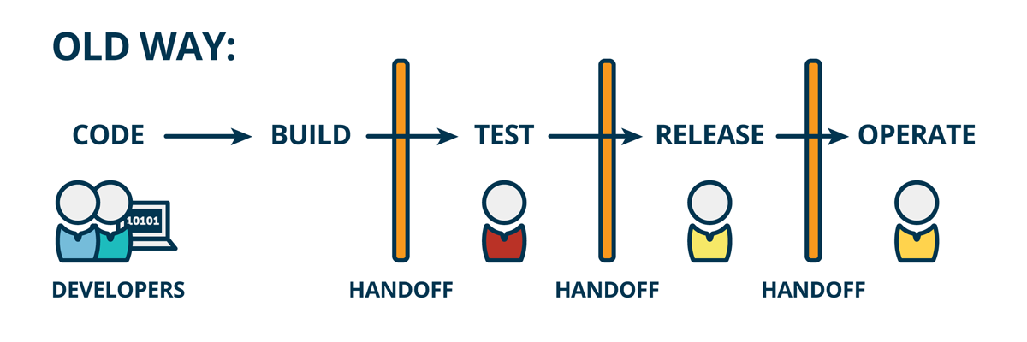
DevSecOps – The Old Way
Notes:
Speaker Notes: This diagram illustrates what we often refer to as 'the old way' of software development and deployment, before the widespread adoption of DevOps principles.
As you can see, it's a very linear, sequential process.
It starts with 'CODE' being produced by 'DEVELOPERS.'
This code then moves to 'BUILD,' which is typically a separate stage.
Crucially, after 'BUILD,' we see the first 'HANDOFF' indicated by the vertical bars and the figures below. This represents a transfer of responsibility, often from development to a testing team.
The process continues to 'TEST,' then another 'HANDOFF,' often to a release management team.
Following 'TEST' is 'RELEASE,' and after yet another 'HANDOFF,' the software finally moves into 'OPERATE' for ongoing maintenance and support.
This traditional model is characterized by these distinct handoffs between specialized teams, which can often lead to delays, miscommunication, and a lack of shared ownership throughout the lifecycle.

Slide 61
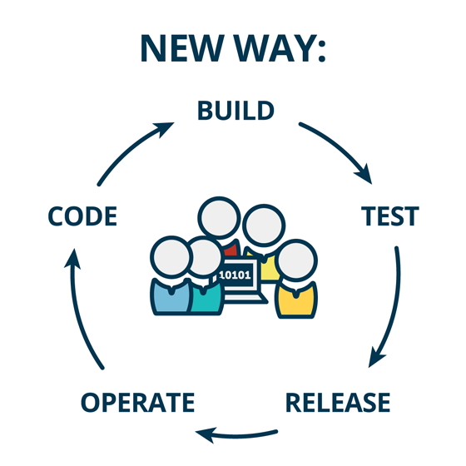
DevSecOps – The New Way
Notes:
Speaker Notes: In contrast to the linear 'old way,' this diagram illustrates the 'New Way' of DevOps, which is fundamentally a continuous and collaborative cycle.
Here, we see a perpetual loop with no hard 'handoffs' or silos. The process begins with 'CODE' and flows into 'BUILD,' then directly to 'TEST.'
From 'TEST,' it moves to 'RELEASE,' and then seamlessly into 'OPERATE.' The key is that 'OPERATE' feeds directly back into 'CODE,' creating a continuous feedback loop. This supports concepts like frequent delivery.
At the center of this cycle, we have a group of figures with a laptop, symbolizing the integrated, cross-functional team – the developers, operations, and security working together throughout the entire lifecycle.
This continuous cycle emphasizes collaboration, automation, and rapid feedback, allowing for faster iterations, quicker problem-solving, and more reliable delivery of digital services.

Slide 62
DevSecOps on Federal Projects
DevSecOps helps federal agencies deliver stable, scalable, and secure digital services that meet mission needs—without sacrificing speed, quality, or compliance.
Automates code deployment and testing to reduce manual errors
Speeds delivery of new features while maintaining security
Maintains robust, compliant systems with continuous monitoring
Supports secure data handling and reliable backups
Notes:
Speaker Notes: Let’s talk about DevSecOps and why it matters in federal digital service delivery.
At a high level, DevSecOps helps agencies deliver stable, scalable, and secure digital services—all while meeting mission needs. Importantly, it does this without sacrificing speed, quality, or compliance.
Here’s how:
First, it automates code deployment and testing. This reduces manual errors—one of the biggest risks in traditional software delivery—and allows teams to release updates more confidently.
It also speeds up delivery of new features. With DevSecOps, agencies don’t have to wait for lengthy release cycles. They can deploy improvements continuously, while maintaining high security standards.
Continuous monitoring ensures systems stay compliant and resilient over time—not just at launch. This is critical for federal programs with strict security and performance requirements.
Finally, it supports secure data handling and ensures reliable backups, helping agencies safeguard sensitive information and maintain trust.
For procurement professionals, understanding DevSecOps helps you write contracts that support modern delivery models—and avoid approaches that slow down innovation or increase risk.

Slide 63
HCD + DevSecOps: The power combo
"Design is the compass, and DevSecOps is the engine."
Combined approach supports user value + technical reliability
Promotes shared responsibility across teams
Notes:
Speaker Notes: When we combine HCD and DevSecOps, we’re aligning the user’s needs with the system’s performance and security. This combination is key in digital transformation efforts.

Slide 64
Activity: Create a Sprint Backlog
Using a fictional case study (e.g., a federal agency project) to create a sample sprint backlog, breaking it into user stories.
Participants will work in groups to prioritize tasks and plan the sprint.
Notes:
See facilitator guide for detailed instructions

Slide 65
Digital Service Delivery Providers: Sources of Supply

Slide 66
The Government Ecosystem
Agencies now have in-house digital service teams (e.g., U.S. DOGE Service – USDS).
Teams vary in mission and structure but share goals:
Promote Agile, iterative development
Apply human-centered design (HCD)
Improve procurement (e.g., modular contracting)
Support implementation and delivery
Notes:
Speaker Notes:
Many federal agencies have created their own internal digital service teams, like the U.S. Digital Service. These teams help modernize outdated systems and ensure services are built around user needs. They often work directly with program offices, advising on procurement and even stepping in to help guide delivery. Their ability to bring technical and agile expertise into the agency makes them powerful collaborators.

Slide 67
The Private Sector Landscape
Vendors provide critical expertise and capacity:
Large firms (IBM, Booz Allen)
Resellers & value-add resellers
Non-traditional firms (startups, commercial tech)
Joint ventures and shared service providers
Public-private partnerships
External vendors complement internal teams.
Notes:
Speaker Notes:
Private companies play an equally important role in delivering digital services. From major IT contractors to nimble startups, these vendors offer talent and tools that agencies may not have in-house. The ecosystem includes everything from resellers to public-private partnerships. Understanding the types of suppliers and how they operate helps procurement professionals make more informed decisions when awarding digital service contracts.

Slide 68
The growing digital service supplier community
Many companies now specialize in public-sector digital services.
Digital Service Coalition (DSC) includes numerous active vendors.
Notes:
Speaker Notes:
The digital service supplier community is growing. Groups like the Digital Service Coalition include companies that are already working with the government to deliver modern services.

Slide 69
Choosing the Right Contract Vehicle
Contract Vehicles Overview
Selecting the right vehicle impacts speed and flexibility.
Common options:
Open Market – Full competition via SAM.gov (RFPs, RFIs, RFQs)
GWACs – Cross-agency contracts for complex IT (e.g., SEWP V, Alliant 2)
GSA MAS – Broad vendor access with pre-negotiated terms
Agency-Specific Vehicles – Tailored BPAs/IDIQs (e.g., VA SPRUCE, SEC BPA)
Agency-specific vehicles increasingly support Agile and HCD practices.
Notes:
Speaker Notes:
After identifying your supplier type, choosing the right contract vehicle is a critical next step. This decision affects how fast you can move forward and how much flexibility you’ll have during the acquisition. Options range from full and open competition to specialized contract vehicles designed for speed and iteration. Pay special attention to agency-specific BPAs and IDIQs—they’re often purpose-built for digital services.

Slide 70
Collaboration Models Between Agencies and Vendors
Common Collaboration Models
Staff Augmentation: Vendors fill specific skill gaps on federal teams
Full Team Delivery: Vendors handle delivery independently
Co-Delivery / Hybrid Teams: Integrated vendor-agency teams with shared roles
Choose based on budget, risk, and delivery needs.
Notes:
Speaker Notes:
Once a contract is in place, how the work gets done matters just as much. Collaboration models shape the delivery approach. Staff augmentation gives you talent support, full-team delivery gives you a turnkey product, and hybrid teams let federal and vendor staff collaborate closely. Many digital service projects benefit from the shared accountability and learning that hybrid teams provide.

Slide 71
Real examples of “Who does what”
“Who Does What” in practice
Example 1: Vendor conducts user research; agency owns backend
Example 2: Large integrator runs DevSecOps; consultancy leads UX
Example 3: Joint sprint planning between vendor and internal product team
Hybrid delivery depends on clear roles, communication, and shared goals.
Notes:
Speaker Notes:
These examples show what hybrid collaboration looks like in the real world. It’s not just about who’s doing what—it’s about creating the right mix of capabilities across both vendor and federal staff. The most successful projects define roles clearly, maintain strong communication, and align around shared outcomes. As a contracting officer, you help set the stage for this alignment through the structure and terms of the acquisition.

Slide 72
Sprint 3
Digital Services Tech Bootcamp

Slide 73
Why Digital Service Tech Matters
Today’s acquisition professionals operate in a fast-changing digital environment.
From cloud platforms to custom software, your work increasingly intersects with technology.
Understanding key digital concepts helps ensure that procurement supports secure, scalable, user-centered public services.
Notes:
Speaker Notes:
This module is where digital service tech and acquisition intersect. You don’t need to become a tech expert—but you do need to understand enough to shape smart, mission-aligned contracts.

Slide 74
Five essential tech topics
Topic | Description
Data | Enables insight, impact measurement, and improved operations
Software | Powers agency workflows; must be licensed and maintained
Cloud | Flexible computing services; requires adaptive contract structures
Artificial Intelligence (AI) | Supports smarter decision-making; needs ethical and secure sourcing
Cybersecurity | Safeguards systems and data; must be built into every contract
Notes:
Speaker Notes: Understanding these fundamentals helps you write better RFPs, evaluate vendor capabilities, and protect your agency’s mission.

Slide 75
Digital Service Tech Topic: Data

Slide 76

Activity: Discussion
Can anyone give an example of a type of data you use every day in your job?
Notes:
Facilitator themes to look for:
Operational or performance data (e.g., contract timelines, spending data)
Market research data (e.g., past awards, vendor capabilities)
End user feedback or service delivery metrics
Procurement data (e.g., FPDS-NG, SAM.gov)
Use of structured vs. unstructured data
Data visibility and accessibility challenges

Slide 77
What Is Data (and Why It Matters)
Common government examples: contractor performance records, purchase histories, emails, budget logs.
Three types of data:
Structured: Spreadsheets, databases
Unstructured: PDFs, emails, social media
Semi-structured: Websites with tags
Notes:
Speaker Notes:
Introduce the basics and connect data types to everyday procurement documentation. Emphasize that acquisition professionals often manage and make decisions based on these different forms of data.

Slide 78
Key Data Topics for Contracting Officers
Data modernization: Upgrading infrastructure and practices
Data migration: Moving data across systems
Data analytics: Using data to drive decisions
Data lakes & ETL: Managing massive, mixed-format data
Data provenance: Tracking data’s origin and changes over time
Notes:
Speaker Notes:
Introduce these terms as “buzzwords” that COs will hear in solicitations and proposals. Encourage COs not to ignore them—understanding these concepts helps in evaluating vendor claims and identifying red flags.

Slide 79
Open Data & Data Privacy – What You Need to Know
Open Data:
Freely accessible and reusable public info
Promotes transparency, efficiency, and innovation
COs must consider:
Licensing and data rights
Privacy risks from dataset combinations
Publishing standards in contracts
Data Privacy:
Legal responsibility to protect sensitive info (SSNs, contract data)
COs ensure compliance with the Privacy Act and agency policies
Ask vendors about data handling and storage practices
Notes:
Speaker Notes:
Stress that contracting officers are both data stewards and users. They must understand what data can be shared, what must be protected, and how to build appropriate protections into contracts.

Slide 80
Activity: Discussion
What’s one question about data you could ask the next time you're reviewing a tech proposal?
Notes:
Facilitator themes to look for:
How will data be stored, accessed, and shared?
Who owns the data (vendor vs. agency)?
Data interoperability and portability
Compliance with data standards (e.g., metadata tagging, privacy rules)
Use of analytics or dashboards for monitoring
Security or classification of data

Slide 81
Digital Service Tech Topic: Software

Slide 82
Understanding Modern Software and Development
What is software?
Instructions, data, or programs that enable computers and digital systems to perform specific tasks
Includes source code (human-readable) and compiled code (machine-executable)
CO note: Clarify source code vs. compiled access during procurement
How software is developed:
Software Development Lifecycle (SDLC): waterfall vs. Agile
Agile approaches: Scrum (sprints), Kanban (flow)
Iteration + feedback loops = key to better software
Example: VA.gov updates using Agile and open-source tools
Notes:
Speaker Notes: Emphasize that understanding development methods helps COs evaluate project progress, contract types, and vendor capabilities.

Slide 83
Activity: Discussion
What benefits and challenges might agile development methods present to contracting officers?
Notes:
Facilitator themes to look for:
Flexibility vs. scope definition tension
Measuring performance or value in agile terms
Incremental delivery and payment structuring
Difficulty aligning agile with traditional FAR-based contracting
Clarity in roles/responsibilities during sprints

Slide 84
Software Supply Chain
Developers reuse code (libraries, packages)
Risks: security, licensing, and maintenance
SBOM = like a parts list to track and manage these components

Slide 85
How Software Is Delivered and Updated
Delivery models:
Local (installed on device) – e.g., Excel
On-premises (hosted in gov’t data centers) – e.g., DOE systems
Cloud-based (SaaS, PaaS, IaaS) – scalable, vendor-hosted
Apps (via app stores) – often rely on cloud services
How software is updated:
CI/CD pipelines = frequent, automated updates
Git/version control tracks changes and supports collaboration
Testing (automated + human) ensures quality and accessibility
Environments: dev → test → staging → production
Risk management tools: canary testing and feature flags
Notes:
Speaker Notes: COs should ensure vendors include testing and update processes in proposals—updates aren’t optional; they’re ongoing.

Slide 86
Activity: Discussion
Why is continuous integration and continuous delivery (CI/CD) beneficial for government software deployments?
Notes:
Facilitator themes to look for:
Faster bug fixes and security patches
Enables user feedback integration
Increased transparency of progress
Automated testing and deployment pipelines
Procurement alignment challenges with frequent delivery

Slide 87
Understanding the Software Supply Chain
Modern software is assembled, not built from scratch
Composed of open-source libraries, third-party tools, proprietary code, and APIs
Why this matters:
Untracked components can create hidden security risks or licensing conflicts
Key tool for risk management:
SBOM (Software Bill of Materials) = a list of all components in the software
Enables vulnerability tracking
Increasingly required in federal procurement
Key questions COs should ask:
Do you use SBOMs?
Do you monitor for vulnerabilities and apply patches?
Notes:
Speaker Notes: Draw parallels to physical procurement—just like you’d want a parts list for a vehicle or hardware, you need a parts list for software too.

Slide 88
Activity: Discussion
What role does a Software Bill of Materials (SBOM) play in managing risk?
Notes:
Facilitator themes to look for:
Supply chain transparency
Identifying vulnerabilities in third-party libraries
Cybersecurity compliance and incident response
Contract requirements for secure development

Slide 89
Licensing, Vendor Lock-In, and Procurement Strategy
Types of software licenses:
Proprietary: Restricted access, higher vendor dependency
Open-source: More flexible and customizable, but terms vary
Why licensing matters:
Affects cost, compliance, and ability to modify or reuse software
Poor license management = risk of contract violations
Vendor Lock-In Risks:
Proprietary formats
Limited data portability
Lack of open standards
Key questions COs should ask:
Can we export our data?
Does the vendor use open standards?
Could another vendor maintain this system if needed?
Notes:
Speaker Tip: Licensing isn't just legalese—it affects how flexible, scalable, and maintainable a software investment will be over time.

Slide 90
Activity: Discussion
What are the major tradeoffs between proprietary and open-source software from a procurement perspective?
Notes:
Facilitator themes to look for:
Cost savings vs. vendor support availability
Licensing and intellectual property terms
Security and patching
Long-term maintenance and portability
Avoiding vendor lock-in

Slide 91
Design Standards and Procurement Implications
Standards and policies:
21st Century IDEA Act
U.S. Digital Services Playbook
Procurement considerations for COs:
Ask for user research and iterative design
Support modular delivery and API-based architecture
Encourage systems that meet performance benchmarks (e.g., page load time, reliability)
Continuous Improvement:
Use analytics + user feedback to evolve systems
Procurements should include monitoring and update cycles
Notes:
Speaker Notes: COs don’t just buy software—they shape the systems citizens use. Contracts should support flexibility, inclusion, and evidence-based improvements.

Slide 92
Activity: Build a Digital Service Workshop
You’ve been asked to create a new government digital service to help a specific user group (e.g., veterans seeking housing assistance, small businesses applying for permits, or students applying for federal aid).
Your mission: In small groups, sketch out a high-level concept for the service and address the following:
What is the core user need?
What does the interface/wireframe look like?
How will you ensure accessibility and iterative feedback?
What procurement considerations or contract decisions will enable this?
Notes:
See facilitator guide for detailed information on this activity.

Slide 93
Activity: Build a Digital Service Workshop
Group roles:
Facilitator – keeps team on track
Note taker/sketcher – captures wireframe and key points
Presenter – shares out to full group
CO/COR rep – advocates for procurement alignment
Notes:
See facilitator guide for detailed information on this activity.

Slide 94
Activity: Build a Digital Service Workshop
Deliverables for each group:
Description of digital service
Wireframe or sketch (rough is fine!) of a user-facing interface or service flow
Accessibility considerations (What barriers will you address?)
Feedback loop (When/how will users or stakeholders provide input?)
Key procurement decisions (What contract features support delivery? Modular? Coaching? ATO strategy?)
Notes:
See facilitator guide for detailed information on this activity.

Slide 95
Activity: Build a Digital Service Workshop
Group presentations
Each team presents:
Their service concept (1–2 minutes)
Key design choices and how they support user needs
Procurement or delivery decisions (tools, contracts, phasing, feedback channels)
Notes:
See facilitator guide for detailed information on this activity.
Speaker notes

Slide 96
Digital Service Tech Topic: Cloud

Slide 97
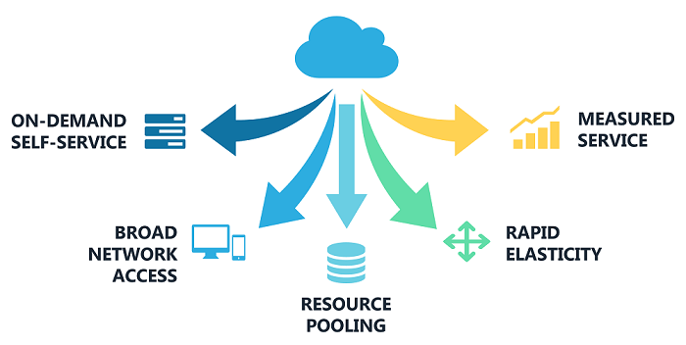
What Is Cloud Computing?
Cloud = flexible access to computing resources via the internet
Not one “cloud”—many vendors, models, and services
NIST defines five essential features:
On-demand self-service
Broad network access
Resource pooling
Rapid elasticity
Measured service
Source: https://cic.gsa.gov/basics/cloud-basics
Notes:
Speaker Notes: Cloud isn’t just about storage—it’s about speed, scalability, and efficiency. These five characteristics help explain why cloud is transforming how agencies manage IT, and why acquisition must evolve too.

Slide 98
Activity: Discussion
How can your agency decide the best way to use (or not use) cloud to support your mission?
Notes:
Facilitator themes to look for:
Mission-critical needs vs. scalability
Cost models (pay-as-you-go vs. fixed infrastructure)
Flexibility and speed of deployment
Security requirements and data classification
Internal capacity for managing cloud services

Slide 99
Cloud Delivery Models
Deployment Types:
Public cloud → Shared third-party services
Private cloud → Exclusive to one agency
Community or hybrid → Collaborative/shared setups
Service Models:
SaaS – ready-to-use apps
PaaS – developer tools and platforms
IaaS – infrastructure like servers and storage
Notes:
Speaker Notes:
Procurement must reflect both deployment and service models. Your contract might involve SaaS with shared hosting or PaaS tools hosted in a hybrid cloud. Know the differences—this affects pricing, security, and compliance.

Slide 100
Why Cloud Procurement Requires a Different Approach
Elastic, scalable—not fixed assets
Service offerings evolve quickly
Pay-as-you-go replaces up-front costs
Shared responsibility model: vendor + agency
Risks of using traditional models:
Wasted spending
Missed services
Incomplete oversight
Notes:
Speaker Notes: Treating cloud like hardware procurement leads to contract mismatches. Understand dynamic pricing, build flexibility into agreements, and expect vendors to manage part of the IT environment

Slide 101
Activity: Discussion
In a shared responsibility model, where do you think misunderstandings between vendors and agencies are most likely to occur? What could be done contractually to prevent that?
Notes:
Facilitator themes to look for:
Assumptions about who handles patching or access controls
Gaps in monitoring responsibilities (e.g., SIEM integration)
Lack of clarity in SLAs
Need for clearer delineation in contract language
Role of onboarding and joint governance reviews

Slide 102
Keys to Cloud Success
Security:
FedRAMP-authorized services
IAM, vulnerability management, SIEM tools
Shared security responsibilities
Governance:
Include IT, CORs, cyber, finance, and program staff
Monitor cloud usage, cost trends, and technical performance
Cost Control:
Price varies monthly—skills matter more than sticker price
Plan for training, dynamic pricing, and cost monitoring
Notes:
Speaker Notes:
Cloud brings new governance needs. Build strong internal oversight, expect vendors to follow best practices, and structure contracts to avoid “surprise” costs.

Slide 103
Choosing the Right Cloud Strategy
Match vendor capabilities to agency needs (e.g., AI/ML, security)
Consider multi-cloud or hybrid-cloud architecture
Avoid:
Restrictive or siloed contracts
Shadow IT caused by limited access
Missing out on volume discounts
Include:
Marketplace access
Architecture planning in pre-solicitation
Scalable usage across the agency
Notes:
Speaker Notes:
Cloud architecture affects mission success. Procurement must allow flexibility—think beyond one app or one program and plan for the enterprise.

Slide 104
Activity: Discussion
How can we encourage modular or hybrid cloud strategies without overcomplicating procurement? What role should vendors play in helping agencies architect for resilience?
Notes:
Facilitator themes to look for:
Building in flexibility and portability in architecture
Use of interface standards and microservices
Encouraging vendor collaboration across silos
Balance between “future-proofing” and current needs
Structuring contracts for interoperability and scalability

Slide 105
Cloud Procurement: The Bottom Line
Cloud is not plug-and-play—training is essential.
Build training milestones and best practices into contracts.
Understand shared responsibility and pricing structures.
Tailor SLAs, security clauses, and contract language accordingly.
Notes:
Speaker Notes:
You don’t need to be a cloud engineer, but you do need to understand how cloud impacts pricing, security, and outcomes. By modernizing your procurement approach, you help protect your agency from waste, risk, and failure.

Slide 106
Digital Service Tech Topic: Artificial Intelligence

Slide 107
What Is Artificial Intelligence (AI)?
AI = systems that perform tasks requiring human intelligence.
Used in:
Chatbots for citizen services
Document summarization and classification
Fraud detection
Market research analysis
Helps automate decision-making, much like automation streamlined paperwork.
Notes:
Speaker Notes:
AI is more than a buzzword—it's being used today in real tools to help agencies operate more efficiently. Think of it as the next level of automation: helping us analyze, decide, and respond faster. As a CO, you’ll increasingly see proposals that include AI capabilities.

Slide 108
Activity: Discussion
What kind of procurement decisions do you think shouldn’t be made by AI? Why?
Notes:
Facilitator themes to look for:
Source selection or technical evaluations (bias risk)
Sensitive or high-risk decisions requiring human judgment
Equity and fairness concerns
Legal and policy compliance
Transparency and auditability

Slide 109
Types of AI
Rule-Based Systems: Advanced if-then logic
Machine Learning (ML): Learns from data to predict or classify
Natural Language Processing (NLP): Understands and summarizes human language
Generative AI (e.g., ChatGPT): Creates new content like draft text or summaries
Notes:
Speaker Notes:
There’s not one kind of AI—there are many. Some tools are simple decision trees, while others generate entirely new content. Knowing the difference helps you evaluate whether a solution fits the problem and what level of oversight it requires.

Slide 110

AI Is Dangerous, but Not for the Reasons You Think
Notes:
Speaker Notes:
This video helps us turn our attention to the present-day consequences of AI—like its environmental cost, ethical misuse, and societal harm—rather than distant, speculative risks. Luccioni encourages us to think about AI accountability now, by building tools for transparency and responsible AI development.

Slide 111
Key Considerations for Using AI in Government
Transparency: Can the AI explain its decision?
Bias: Is the training data fair and representative?
Security & Privacy: Does the system protect sensitive info?
Change Management: Will it affect roles and workflows?
Vendor Oversight: How is the AI trained, tested, and updated?
Notes:
Speaker Notes:
With great power comes great responsibility. AI must be transparent, fair, and secure. Your role is to ask tough questions and ensure vendors can explain how their systems work—and how they’re being monitored.

Slide 112
Key AI Terms
Model Training: Teaching the AI using data
Algorithm: The rules it follows
Inference: Applying what it learned
Explainability: Why it made a decision
Human-in-the-loop: Human + AI collaboration
Notes:
Speaker Notes:
You don’t need to become a data scientist, but these basic terms will help you evaluate AI proposals and hold vendors accountable. “Explainability,” in particular, is key for audits and defensibility.

Slide 113
Why AI Matters in Procurement
Market Research: AI can summarize vendor data and trends
Performance Monitoring: Flags contractor issues early
Drafting Support: Generates first drafts for solicitations
Risk Management: COs must watch for bias, explainability, and compliance
Evaluation Criteria: Require vendors to describe data sources, bias mitigation, and audit methods
Notes:
Speaker Notes: AI can boost procurement efficiency—but also introduces new risks. Be thoughtful when drafting requirements. If you're procuring AI, include expectations for transparency, performance, and continuous oversight.

Slide 114
Activity: Discussion
If a vendor says their tool uses “machine learning,” what’s one question you’d ask before moving forward?
Notes:
Facilitator themes to look for:
What data is used to train the model?
Is the algorithm explainable and auditable?
What bias mitigation strategies are in place?
Can the agency fine-tune or update the model?
Does the tool require human oversight?

Slide 115
What COs Should Keep in Mind
Ask vendors how the AI works and how it’s updated.
Not every task needs AI—look for real value, not hype.
Balance innovation with clear requirements and accountability.
Be a responsible steward: prioritize ethics and transparency.
Watch for model drift post-award—AI must evolve with agency needs.
Notes:
Speaker Notes:
You are the frontline for responsible AI in government. Ask tough questions, insist on clear answers, and structure your contracts to support long-term performance, not just flashy demos. AI may change, but your role in protecting mission success doesn’t.

Slide 116
Activity: Procure or Pass?
You’ll see a series of short AI use cases. For each, we’ll ask: Would you procure it? What conditions or questions would you raise?
Notes:
See facilitator guide for detailed information on this activity.
Speaker notes: Emphasize that there’s no single correct answer, but the goal is to surface different perspectives.

Slide 117
Activity: Procure or Pass?
Use Case 1:
A vendor proposes an AI auto-scoring tool to evaluate and rank RFP responses based on pre-trained relevance criteria.
Notes:
See facilitator guide for detailed information on this activity.
Speaker notes: Would you procure or pass? What ethical questions arise around data inputs and use?
Follow up with open questions to spark dialogue:
What’s promising about this use case?
What are your red flags?
What guardrails or contract language would you want in place?

Slide 118
Activity: Procure or Pass?
Use Case 2:
A chatbot answers incoming FOIA requests by pulling from previous, public disclosures.
Notes:
See facilitator guide for detailed information on this activity.
Speaker notes: Would you procure or pass? What ethical questions arise around data inputs and use?
Follow up with open questions to spark dialogue:
What’s promising about this use case?
What are your red flags?
What guardrails or contract language would you want in place?

Slide 119
Activity: Procure or Pass?
Use Case 3:
An agency wants to use an AI résumé screener to filter job applicants before human review.
Notes:
See facilitator guide for detailed information on this activity.
Speaker notes: Would you procure or pass? What ethical questions arise around data inputs and use?
Follow up with open questions to spark dialogue:
What’s promising about this use case?
What are your red flags?
What guardrails or contract language would you want in place?

Slide 120
Activity: Procure or Pass?
Use Case 4:
A cloud-based system uses AI to detect fraud in real-time across benefit applications, flagging anomalies for manual review.
Notes:
See facilitator guide for detailed information on this activity.
Speaker notes: Would you procure or pass? What ethical questions arise around data inputs and use?
Follow up with open questions to spark dialogue:
What’s promising about this use case?
What are your red flags?
What guardrails or contract language would you want in place?

Slide 121
Activity: Procure or Pass?
Use Case 5:
An AI model helps predict program success rates using historical outcomes and demographic data.
Notes:
See facilitator guide for detailed information on this activity.
Speaker notes: Would you procure or pass? What ethical questions arise around data inputs and use?
Follow up with open questions to spark dialogue:
What’s promising about this use case?
What are your red flags?
What guardrails or contract language would you want in place?

Slide 122
Digital Service Tech Topic: Cybersecurity

Slide 123
Activity: Discussion
Have you seen a procurement where security expectations weren’t clearly defined? What happened?
Notes:
Facilitator themes to look for:
Vendor confusion or delays
Security retrofits or costly rework
Lack of accountability during an incident
Audit or compliance failures
Breach of sensitive data

Slide 124
Cybersecurity in Government Digital Services
Cybersecurity is critical to protecting systems, data, and mission continuity.
Modern IT environments (cloud, mobile, AI) increase the federal “attack surface.”
COs and CORs shape cybersecurity posture through planning, contracts, and oversight.
Key terms to understand:
Security compliance
IAM (Identity & Access Management)
Vulnerability management
SIEM (Security Incident & Event Management)
Notes:
Speaker Notes:
Every digital product your agency delivers must be secure by design—not just by audit. As COs and CORs, you’re in a position to demand secure practices from the start. You don’t need to be a cybersecurity expert—but you do need to know what questions to ask and what to require in contracts.

Slide 125
Activity: Discussion
What’s one question a CO could ask during market research to surface security risks early?
Notes:
Facilitator themes to look for:
What frameworks or controls does the solution comply with (e.g., FedRAMP, NIST)?
How is data protected in transit and at rest?
How do you manage software supply chain risk?
What’s your incident response timeline?
Do you support integration with our IAM or SIEM platforms?

Slide 126
Security Compliance & Identity Access Management (IAM)
Security Compliance
Align systems with NIST 800-53, CSF, FedRAMP, HIPAA, etc.
COs/CORs confirm applicable frameworks and support OCISO review.
IAM (Identity & Access Management)
Controls who accesses what and when.
Systems must integrate with your agency’s IAM platform.
Vendors should prove compatibility during acquisition.
Notes:
Speaker Notes:
Compliance isn’t optional—it’s a legal and operational baseline. You must confirm which security frameworks apply to your acquisition and ensure the vendor solution can meet them. With IAM, the main question is: Will this system plug into our current access controls, or will it create more risk?

Slide 127
Staying Ahead of Threats
Vulnerability Management
Not just patching—full lifecycle scanning, triage, and remediation.
Requires ongoing monitoring, compliance tracking, and reporting.
CO/COR role: Ensure vendors have tools, training, and processes in place.
Security Incident and Event Management (SIEM) Integration
Detects and responds to threats automatically.
Must integrate with agency’s platform (e.g., Splunk, Sentinel).
Avoid systems that create “monitoring silos.”
Notes:
Speaker Notes:
Every system has vulnerabilities. Your job is to ensure that vendors can detect, manage, and report them appropriately. SIEM systems are the agency’s eyes and ears—if your procured system can’t talk to the SIEM, you’ve created a blind spot.

Slide 128
Activity: What Would You Ask?
You’re preparing for an early acquisition planning meeting. Based on your assigned topic, come up with 2–3 questions you would ask the technical or security team to ensure this requirement is built into the contract.
Topics:
Security compliance
Identity and Access Management (IAM)
Vulnerability management
SIEM integration
Notes:
See facilitator guide for detailed information on this activity.
Speaker notes: We’ll break out into groups for 10 minutes. During debrief, each group will share their questions.

Slide 129
Key Takeaways
Security must be designed into digital services from the start.
Ask vendors:
How do you handle IAM integration?
What’s your vulnerability management process?
Can your system integrate with our SIEM?
Reference Executive Order 14028, OMB Memos (M-22-09, M-22-18), and NIST guidance.
Through secure procurement, COs protect public trust and mission continuity.
Notes:
Speaker Notes:
Cybersecurity is everyone’s responsibility—but you’re on the front lines. You can prevent weak systems from being procured by asking the right questions early. Build security expectations into requirements, evaluation criteria, and post-award monitoring.

Slide 130
Activity: Discussion
What’s one thing you can do in your next contract to strengthen cybersecurity expectations?
Notes:
Facilitator themes to look for:
Facilitator themes to look for:
Require integration with agency IAM/SIEM
Define patching and vulnerability management processes
Reference federal standards explicitly (e.g., NIST 800-53)
Include performance metrics tied to security practices
Build in security testing and validation checkpoints

Slide 131
Digital Service Tech Topic: Accessibility
Notes:
Speaker Notes:
Today’s session will explore the what, why, and how of accessibility in federal acquisitions. We’ll cover who is impacted, what the law requires, and how procurement teams can ensure the products and services they buy meet accessibility standards.

Slide 132
Why Digital Accessibility Matters
Fundamental to inclusivity and equality
Prevents exclusion from vital opportunities
Required by U.S. law for federal agencies
Benefits go beyond disabilities—helps all users
Notes:
Speaker Notes:
Digital accessibility ensures that everyone, including people with disabilities, can access and interact with digital content. Without it, we risk excluding individuals from jobs, services, and information. Accessibility benefits many—think older adults, people with temporary injuries, or situational limitations.

Slide 133
Types of Disabilities
1 in 4 U.S. adults has some form of disability
Disabilities can be:
Permanent (e.g., blindness, arthritis)
Temporary (e.g., broken arm, concussion)
Situational (e.g., noisy environment, holding a baby)
Impact varies—even among people with the same condition
Notes:
Speaker Notes:
Disabilities don’t all look the same. Understanding the range of experiences—from permanent to situational—helps us design and procure technology that works for the widest group possible.

Slide 134
Barriers & Assistive Technology
Common accessibility issues:
Lack of captions
Low color contrast
Poor navigation structure
Assistive tools include:
Screen readers & magnifiers
Speech-to-text software
Eye gaze & brainwave tech
Notes:
Speaker Notes:
Barriers can appear in content, structure, or function. Assistive technology bridges some gaps, but it’s most effective when the underlying product is designed with accessibility in mind from the start.

Slide 135
Why Accessibility Matters in Procurement
Ensures government services are inclusive for all
Section 508 sets legal obligations
Aligns with WCAG standards for global best practices
Benefits veterans, seniors, and situationally limited users
Notes:
Speaker Notes:
In procurement, accessibility is about making sure digital tools serve both employees and the public—without leaving anyone behind.

Slide 136
Digital Accessibility is the Law
Section 508 of the Rehabilitation Act of 1973
Updated 2017 to align with WCAG 2.0 AA
State/local governments follow WCAG 2.1 AA
Eliminates barriers & fosters inclusive tech
Notes:
Speaker Notes:
Section 508 is not optional—it’s a legal requirement. It sets technical benchmarks that all procured ICT must meet, and these standards evolve as technology advances.

Slide 137
Measuring Accessibility
Accessibility Conformance Report (ACR)
Voluntary Product Accessibility Template (VPAT)
Vendor-provided, but requires verification
Use during procurement evaluation
Notes:
Speaker Notes:
ACRs and VPATs are key tools, but remember—they’re vendor attestations. You must validate them through technical evaluation and, ideally, user testing.

Slide 138
Embedding Accessibility in the Acquisition Lifecycle
Consider accessibility early—less costly, more robust
OMB M-24-08: articulate requirements, get proof vendors can comply
Technical evaluation before & after award
Maintain conformance over time
Notes:
Speaker Notes:
Accessibility isn’t a checkbox—it’s a process. Embedding it in every acquisition phase ensures ongoing compliance and usability.

Slide 139
Phase-by-Phase Actions
Creation: Determine accessibility requirements
Market Research: Consult accessibility SMEs, review ACRs
Solicitation: Include accessibility criteria, reference Section 508/WCAG
Proposal Review: Evaluate plans, ACRs, vendor processes
Post-Award: Require validation testing & updates
Notes:
Speaker Notes:
This step-by-step approach keeps accessibility front and center throughout procurement.

Slide 140
When No Accessible Option Exists
Procure the product that best meets standards
Must be documented per Section 508 E202.7
Avoid procurement challenges by keeping thorough records
Notes:
Speaker Notes:
If no fully compliant product exists, choose the one closest to compliance—and document why. This protects your procurement from disputes.

Slide 141
Common Myths
“ACR = accessible” → Needs real-world testing
“One-time checkbox” → Accessibility breaks over time
“508 doesn’t apply” → Rarely true
“Only for permanent disabilities” → Helps everyone
Notes:
Speaker Notes:
Misunderstandings can lead to noncompliance. Always verify accessibility and remember—it’s about inclusive design for all users.

Slide 142
Your Role
Ensure products are usable by all
Embed accessibility in every acquisition phase
Reduce legal & reputational risk
Serve the public equitably
Notes:
Speaker Notes:
Procurement professionals are gatekeepers for accessibility. Your decisions directly impact who can access and benefit from government services.

Slide 143
Resources & Tools
ACREditor – review/generate ACRs
Accessibility Requirements Tool (ART)
Accessibility Insights – browser plugin
Section 508 resources & sample contract language
Notes:
Speaker Notes:
Use these tools to define requirements, test products, and ensure accessibility is built into your procurement process.

Slide 144
Digital Service Tech Topic: Open Source
Notes:
Speaker notes: Today we’re diving into Open Source Software—OSS—and its role in federal digital services.
It’s not just a tech buzzword—it’s foundational to how modern government services are being built. We’ll explore what OSS is, why it matters for federal procurement, security considerations, and how to evaluate and procure it effectively.

Slide 145
What is Open Source Software?
Source code is openly available for viewing, modifying, and sharing.
Licenses often require sharing modifications under same terms.
Maintained by a community, not a single vendor.
Benefits: cost reduction, innovation, security.
Notes:
Speaker notes: Let’s start with the basics—what is OSS?
Think of the source code as the recipe for the software. With OSS, that recipe is openly available—you can view it, modify it, and share it. Most OSS licenses require you to share your modifications under the same terms. And it’s often maintained by a community, not a single company.
Keep in mind—OSS isn’t a free-for-all. It’s governed by licenses and community norms, and we’ll circle back to that later.

Slide 146
OSS in Everyday Life
Powers billions of devices and most internet infrastructure
Examples: Android OS, Netflix (FreeBSD), Linux (servers, devices), GitHub
Widespread adoption by Fortune 500 companies and governments
Notes:
Speaker notes: You’ve already interacted with OSS today—whether you know it or not.
It powers billions of devices and much of the internet: Android phones, Netflix runs on FreeBSD, most servers run Linux, and code-sharing happens on GitHub. It’s not just tech startups—Fortune 500 companies and governments rely on it.
Which of these examples surprises you most?

Slide 147
Why OSS Matters in Federal Procurement
Cost savings & innovation
Supports vendor independence
FAR classifies OSS as COTS software
Federal Source Code Policy & SHARE IT Act encourage code reuse & sharing
Notes:
Speaker notes:
So why does OSS matter for acquisition professionals?
It can deliver cost savings, spur innovation, and reduce dependence on a single vendor. The FAR actually classifies OSS as COTS software, which makes it easier to acquire. Plus, federal policy—the Source Code Policy and SHARE IT Act—actively encourages reuse and sharing.
This isn’t fringe policy—it’s mainstream and supported.

Slide 148
Security of OSS
Open review speeds vulnerability fixes.
Secure if properly maintained.
Best practices: encryption, authentication, updates, audits.
Government initiatives: Open Source Security Foundation, DoD’s Iron Bank.
Notes:
Speaker notes:
Security is often the first concern people raise.
One myth is that OSS is insecure because it’s open. In reality, openness means more eyes can spot and fix vulnerabilities faster. The key is proper maintenance—encryption, authentication, updates, audits. The DoD’s Iron Bank is a great example of how the government is securing OSS.
What security benefits do you see in this open review model?

Slide 149
The Cost of “Free” OSS
No license fees, but costs for customization, support, hosting, updates.
Avoid vendor lock-in:
Maintain control of data
Keep migration options open
Notes:
Speaker notes:
Another misconception—‘free’ means no cost.
While there’s no license fee, you’ll have costs for customization, support, hosting, and updates. The good news—you avoid vendor lock-in if you plan ahead. Keep control of your data and migration options.
Think about a project you’ve worked on—what ongoing costs might OSS have replaced or reduced?”

Slide 150
Open Source Doesn’t Mean Free
Budget
What are ALL the costs associated with making the software work?
Low Startup Costs
Free download or sign-up
Recurring Costs
Initial Price
COST CONSIDERATIONS
Teaching
How will users/admins get initial and ongoing training?
Decisions
How will the product be tested and evaluated?
Training
Evaluation
Considerations
How will data be stored, protected or validated?
Data Management
Installation
Deployment
How will the product get to the user base?
Notes:
Speaker notes:
There are costs associated with every phase of a software deployment. If the vendor doesn’t call them out, ask. If they’re not clear, ask.
Initial price (cost to host it). - usually free or nominal
Evaluation period - what will it take to get the product through an evaluation and or review period?
Once the decision is made to proceed with it, how will it be deployed throughout the organization?
How will the data be managed? Where is it stored? How is it backed up and otherwise protected? How do these cost evolve over time? As an example, consider that doing all this for a few gigabytes of data today involves one set of practices, but a few terabytes tomorrow may be a whole different story.
How will users be trained? Will the users always just people entering data. Is special training required for certain types of users?
What are the recurring costs? Think about backups? Think about the cost for moving big blocks of data from one location to another. Think about changes required whenever there are new updated or new standards are announced.
In a nutshell the total costs in the long run are often much more than the initial cost.

Slide 151
How to Procure OSS
Phase | Procurement Considerations
Market Research | Explore OSS solutions and evaluate the health of their communities and licensing models.
Solicitation | Avoid overly prescriptive requirements that might exclude OSS. Instead, allow for OSS solutions where viable and include specific evaluation criteria to assess their sustainability and support model.
Proposal Review | Check the vendor's implementation plan to ensure that all software licenses are compatible with your agency's needs. Confirm they contribute to the open-source community and are not simply users.
Post-Award Oversight | Continuously track software maintenance and compliance. If a product with an OSS license was selected, ensure that the software will remain OSS beyond the length of the contract.
Notes:
Speaker notes:
Let’s walk through the acquisition lifecycle with OSS in mind.
Market Research: Look at community health, licensing terms.
Solicitation: Avoid requirements that unintentionally exclude OSS.
Proposal Review: Check licensing and vendor’s OSS contributions.
Post-Award: Track maintenance and compliance.
Where in your current process could these checks make the biggest difference?

Slide 152
Key Takeaways
OSS is everywhere—modern digital services rely on it.
Federal policy supports OSS adoption.
Security can be a strength, not a weakness.
“Free” does not mean “no cost.”
Thoughtful procurement avoids lock-in and maximizes benefits.
Notes:
Speaker notes:
Let’s wrap up with the big picture.
OSS is everywhere, and federal policy supports its adoption. Security can be a strength if you follow best practices. ‘Free’ means different costs, not no costs. And thoughtful procurement helps you avoid lock-in and maximize benefits.
What’s one area in your work where OSS could be a viable solution?

Slide 153
Questions?

Slide 154
Thank you
Contact information
Feedback survey link (if available)

